Slide 1

CH-105 INORGANIC TUTORIAL – I
Topic - III
Department of Chemistry

Slide 2
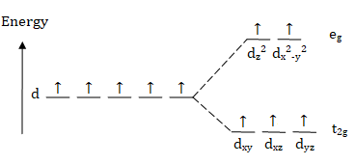
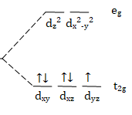
Q01. When high pressure is applied equally in all directions, what type of electronic configuration is favoured for an octahedral high-spin d⁵ transition metal complex?.
Ans. The favoured electronic configuration would be d⁵ low spin.
Reason :
High pressure
Free ion d⁵ high spin d⁵ low spin
When high pressure is applied, the bond length of M-L bond decreases.
As a result of this, ligand starts to behave as a strong field ligand.
Low electron density between the metal & the ligand leads to the formation of low spin d⁵ complex.

Slide 3
Q02. Using the crystal field stabilization energy as criterion, indicate whether you expect the following spinels to be normal or inverse: Fe₃O₄; Co₃O_{4.}
Ans. (a) Fe₃O₄ (Fe²⁺) (Fe³⁺)₂ (O²⁻)₄
Fe²⁺ d₆ CFSE 0.4 Δ_{o}
Fe³⁺ d₅ CFSE 0
(CFSE)_{d6} >> (CFSE) _{d5}
Fe²⁺ prefers Oh instead of Td due to gain in CFSE
That means it is an inverse spinel.
(b) Co₃O₄ (Co²⁺) (Co³⁺ )₂ (O²⁻)₄
Co²⁺ Co³⁺
d₇ d₆
There is a gain in CFSE if Co²⁺ is in Tetrahedral and Co³⁺ is in Octahedral geometry.
That means it is a normal spinel.

Slide 4
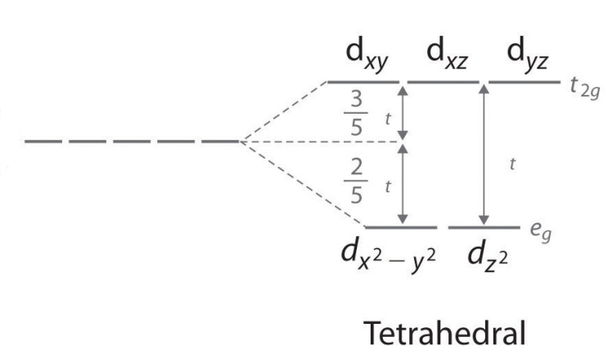
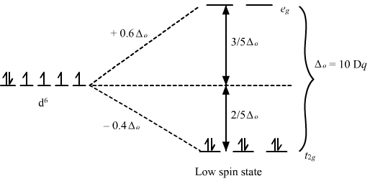
Q03. By showing the details, determine the CFSE for the following complexes: (a) [FeCl₄]²⁻; (b) W(CO)₆.
Ans. (a) In [FeCl₄]²⁻, Fe²⁺ has e³ t₂³ ​ configuration.
CFSE = 0.6 Δ_{t}
(b) In W(CO)₆ , the metal has t_{2g}⁶e_{g}⁰ configuration.
CFSE = -2.4 Δ_{o}
↿ ↿ ↿
↿⇂
↿ ↿ ↿ ↿
↿⇂ ↿

Slide 5
Q04. [Cr(CO)₆] is a stable molecule while [Ni(CO)₆] is very unstable. Rationalize this observation employing Molecular Orbital Theory and draw the corresponding molecular orbital diagrams.
Ans. One is 18 electron complex and other is 22 electron complex. As per MOT, filling the anti-bonding orbital will lead to instability. As this is the case for the [Ni(CO)₆], this is unstable.
M-L → σ-bonding
*
Anti
bonding
*
*
Bonding

Slide 6
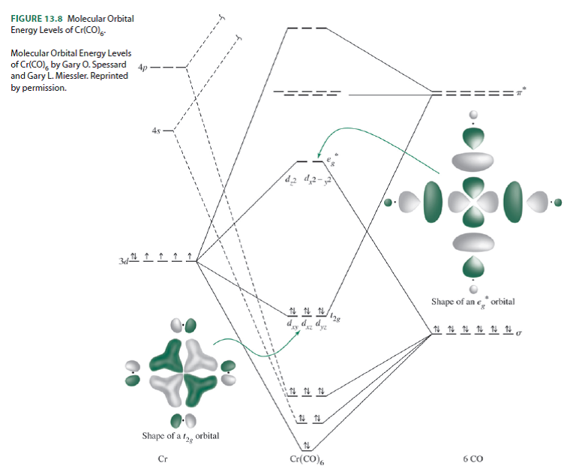

Slide 7
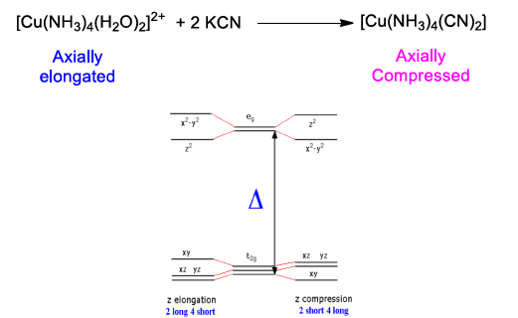
Q05. [Cu(NH₃)₄(H₂O)₂]²⁺ complex reacts with two equivalent of KCN leading to the formation of [Cu(NH₃)₄(CN)₂]. Based on crystal field theory, predict the orbital splitting and the expected geometry for both complexes.
Ans.

Slide 8
Q06. Draw the orbital splitting for the following geometries given .(Assume ligand L as weak field ligand and also label the orbitals.
Ans.

Slide 9
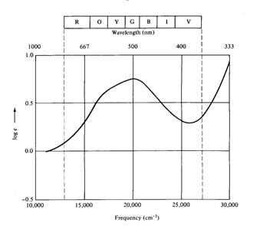
Q 07. For the following compounds [M(NH₃)₆]³⁺ (M=Ti, Zr, Hf), draw the tentative absorption spectra of these compounds.
Ans .
For Ti, 20,300 cm⁻¹ as we go down in the periodic table the crystal field splitting increases, therefore much larger splitting is expected for Zr and Hf with the trend of Ti<Zr<Hf. Show the bands tentatively at higher energy for Zr and Hf.

